Slide 1




From App to Impact
The ZOE Covid Study
Claire Steves
Professor of Ageing and Health

Slide 2
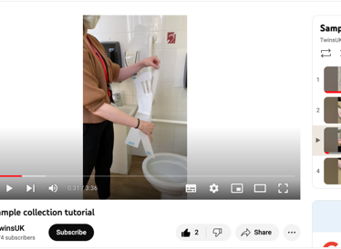
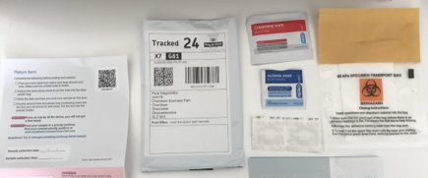
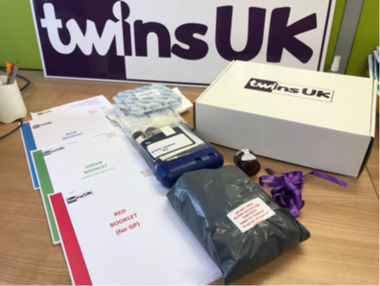
Health Research from Home in TwinsUK since 2017

Slide 3

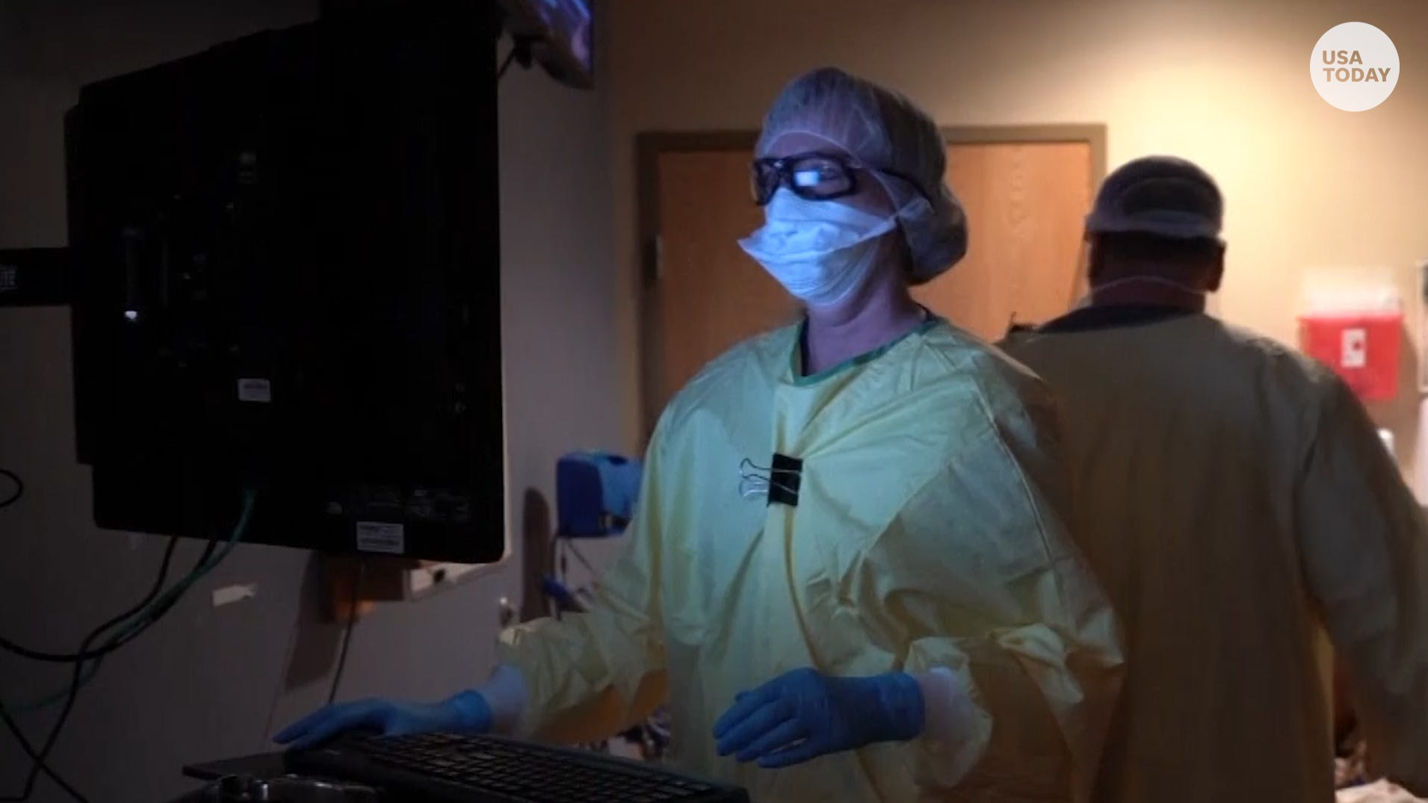
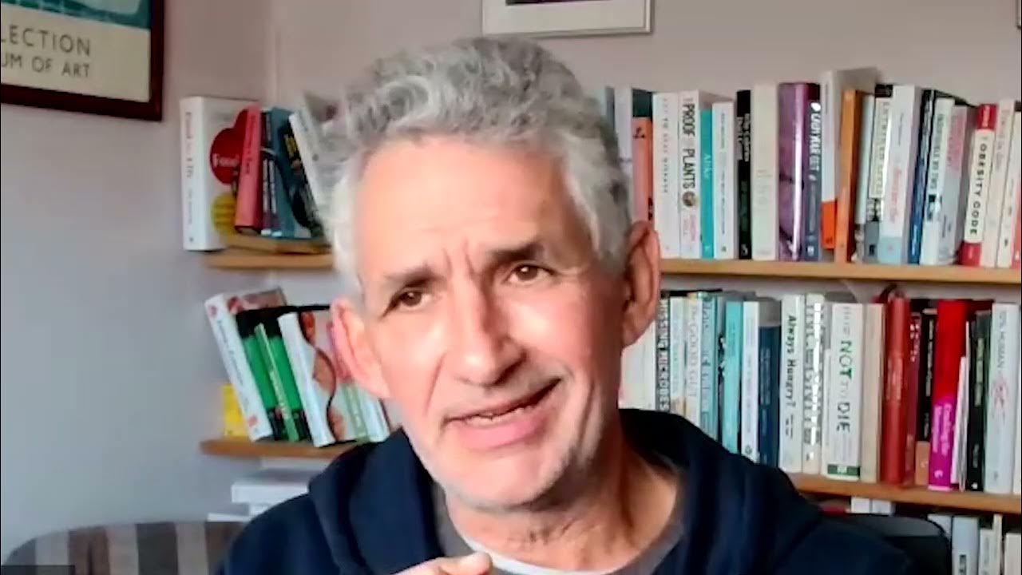
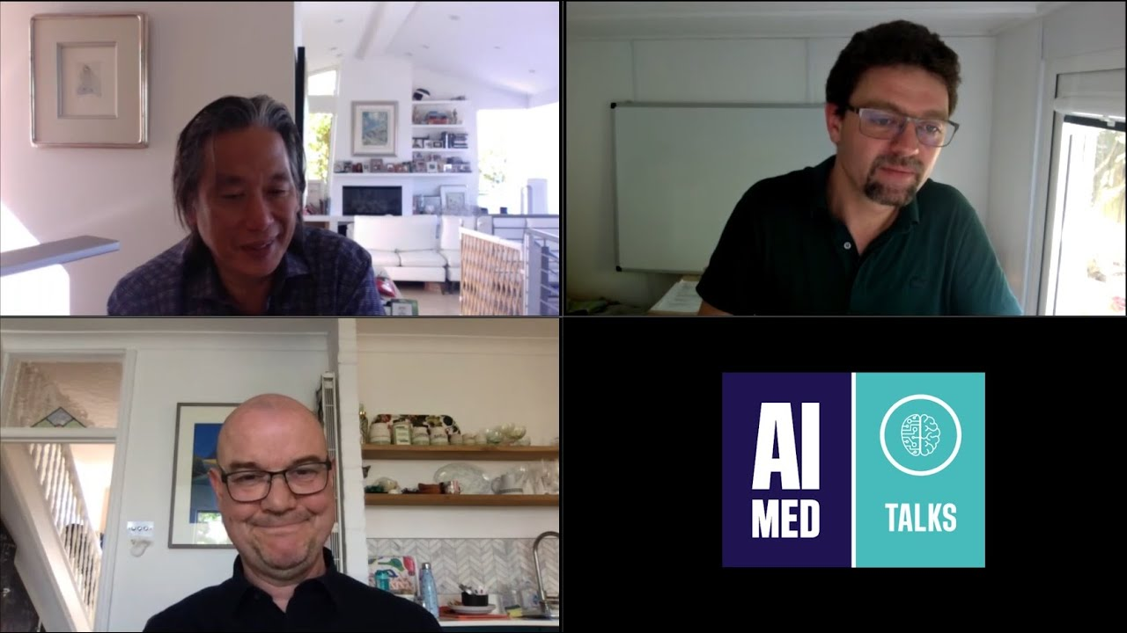
Critical collaboration
Clinical Insight
Public Thirsty for Answers
Good Media Relations
Data
Science infrastructure
Not-for-profit initiative by health science company ZOE and King's College London

Slide 4
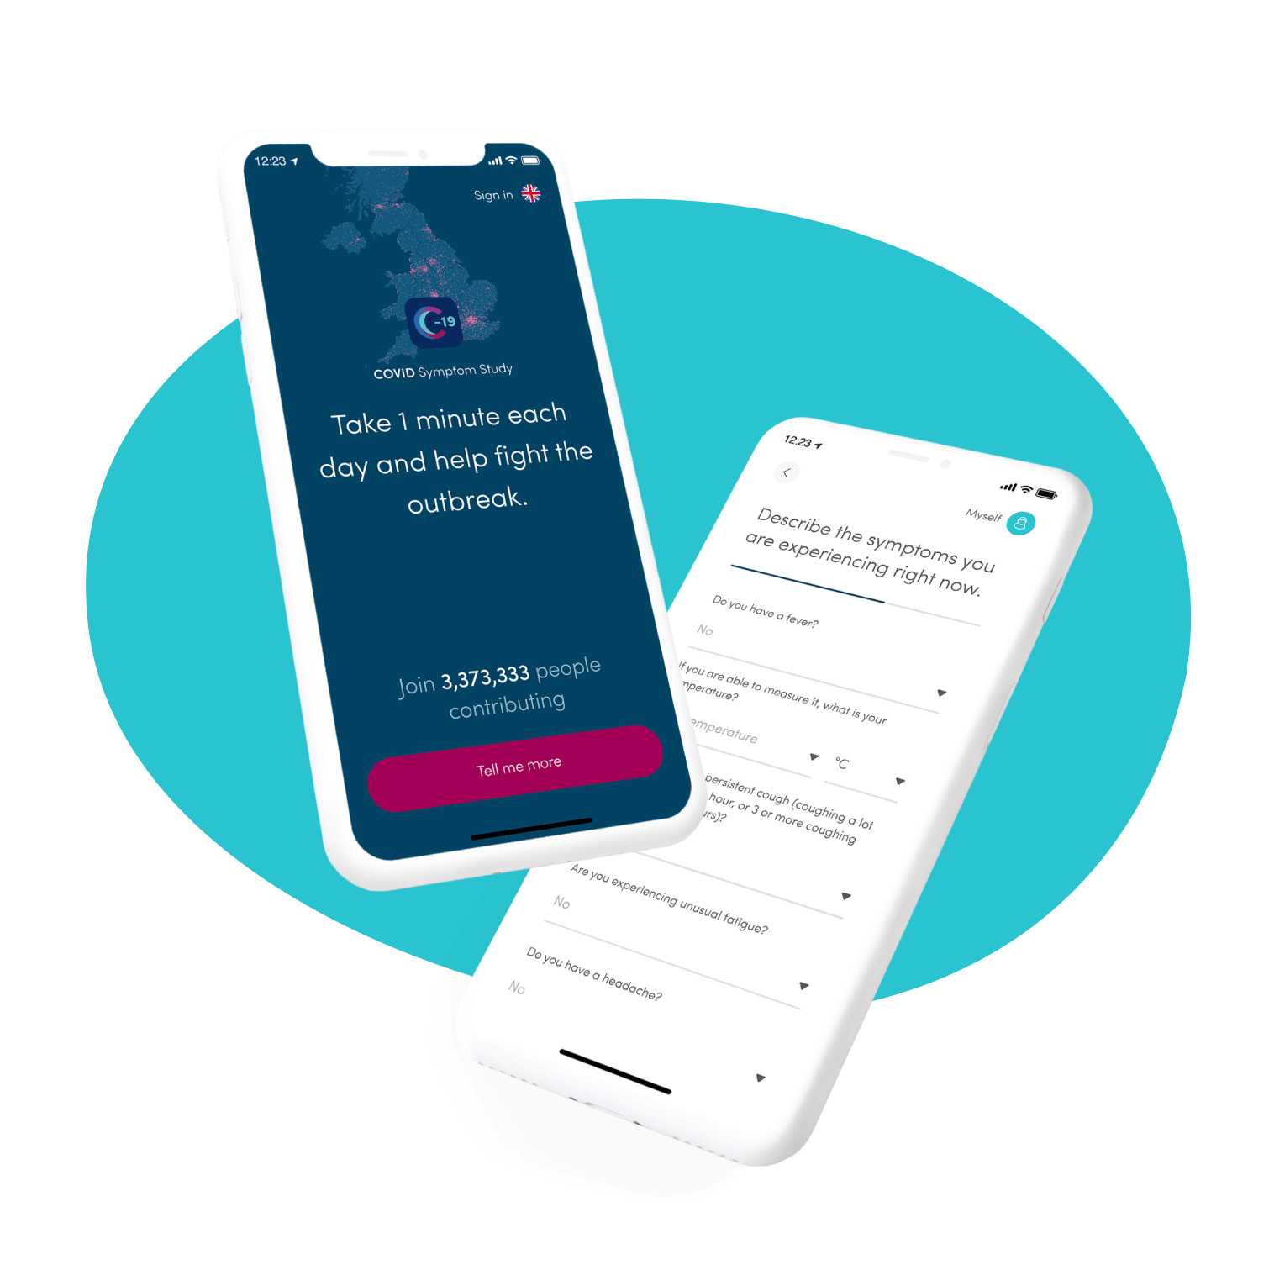
Overview - COVID Symptom Study App
Mobile health project – smartphone app
Benefitted from huge national interest in understanding the disease
Daily logging of symptoms across the pandemic
Report of test results
Required an active pool of loggers
Fine balance to ensure engagement of participants
Continuous development improvement and dissemination

Slide 5
Overview – understanding a disease from the ground
Initial profile
Demographics (Location / Healthcare occupation)
Personal characteristics (Age, Weight, Height…)
Daily log with reminder
Symptoms – binary or ordinal fields, and free text
Other
Level of social interaction
Additional one-off questions or surveys
Treatment/Access to healthcare
Medical history (Diabetes, Lung disease, Cancer…)
Diet study
Vaccinations
Wider health – e.g. blood pressure
Test results (Result, date, mechanism)
Notes:
4.7 million users across the UK, US and Sweden
850,000 daily contributors currently
Over 480 million health reports and 22 million tests
838,518 infections (confirmed by PCR or LFT)
1,580,940 vaccines and 3,908,784 doses recorded
Largest study to date of long Covid cases
Largest diet study in history (592,571)
One of largest mental health studies (413,148)
Not-for-profit initiative by health science company ZOE and KCL
Funded by ZOE and then UKHSA as part of the COVID-19 Surveillance Studies since August 2020 (until April

Slide 6
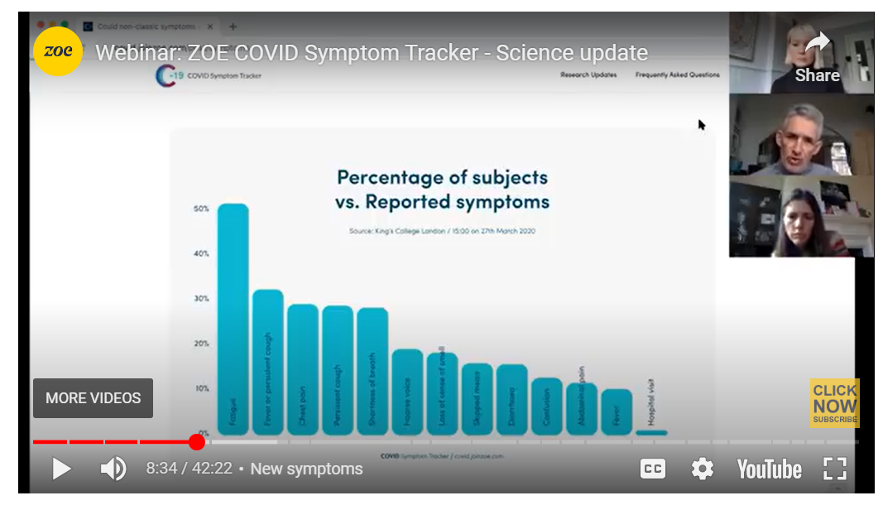
Weekly engagement with our contributors and the public
Weekly podcasts for 2 and a half years!
Daily briefing to policy makers – including Cabinet Office, DHSC, many others..
Individuals could interact with the app to find answers
It was successful because it met contributors needs

Slide 7
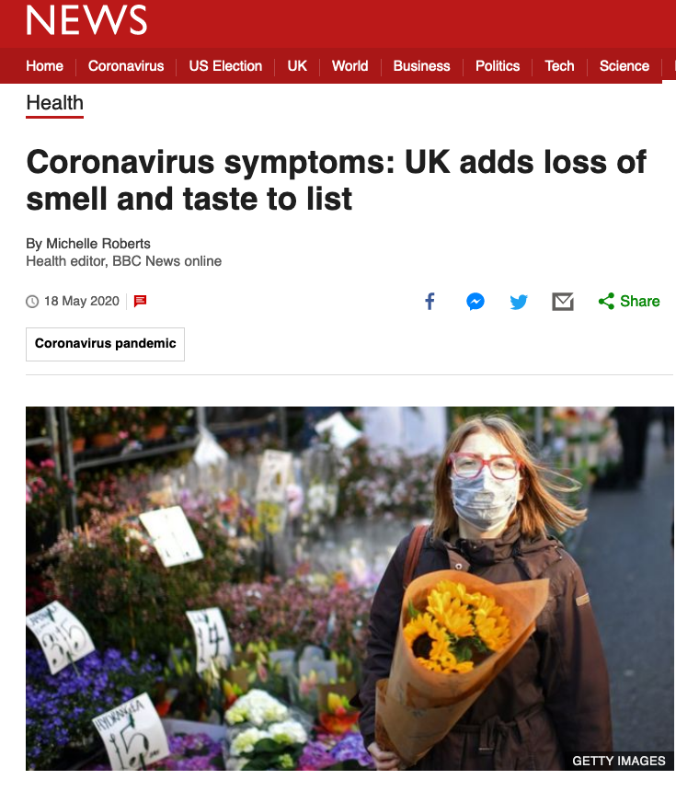
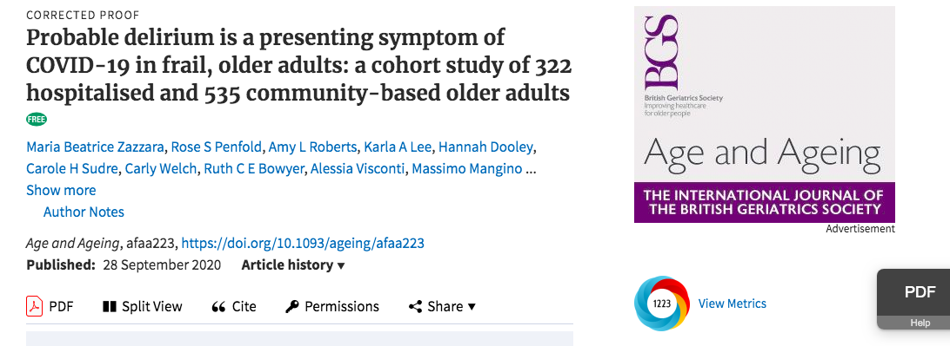
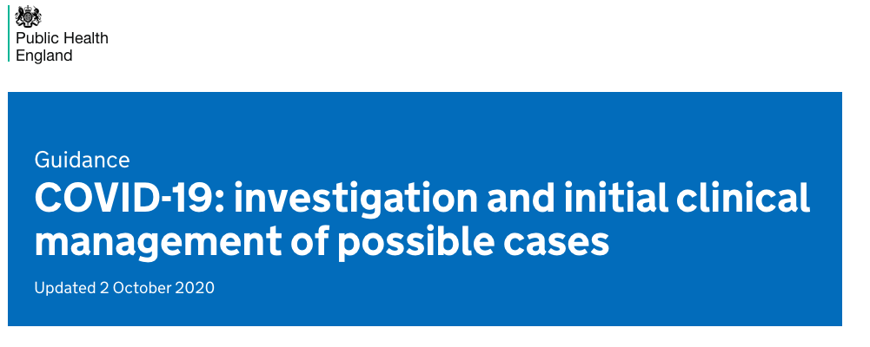
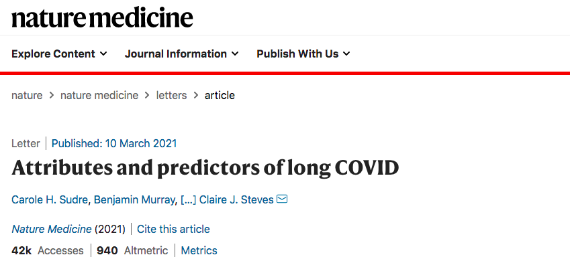
Overview – impacts
Time series of symptoms added something key
43 peer reviewed academic papers
Science x1
Nature Medicine x2
Lancet x1
Lancet Public Health x 3
Lancet Infectious Diseases x2
Direct line to CO, CMO/CSO, now PHE,
TwinsUK – Vanguard of NCS
Notes:
Adding loss of smell to WHO and NHS list
Altering PHE guidance on symptoms in older people (delirium)
In NICE guidance and SAGE reports on Long COVID
Identified risk groups for post-vax infection for booster targeting
Daily reporting on hotspots and changes in R to UKSHA/DHSC
Recruiting to Trials for RCGP, Vaccine taskforce
Regular reporting to UKHSA, Go-Science, SPI-M, MHRA, NHSE, Cabinet Office, – including health behaviours, vaccines and omicron
43+ published research papers,
including Nature Medicine x2, Science, Lancet (x3), Lancet ID (x2)
The App has transformed our links with policy makers
Policy makers are now aware of the power of apps to detect and inform on changes in population health

Slide 8
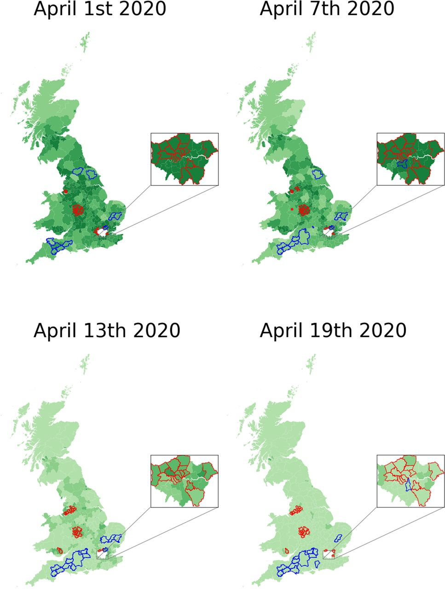
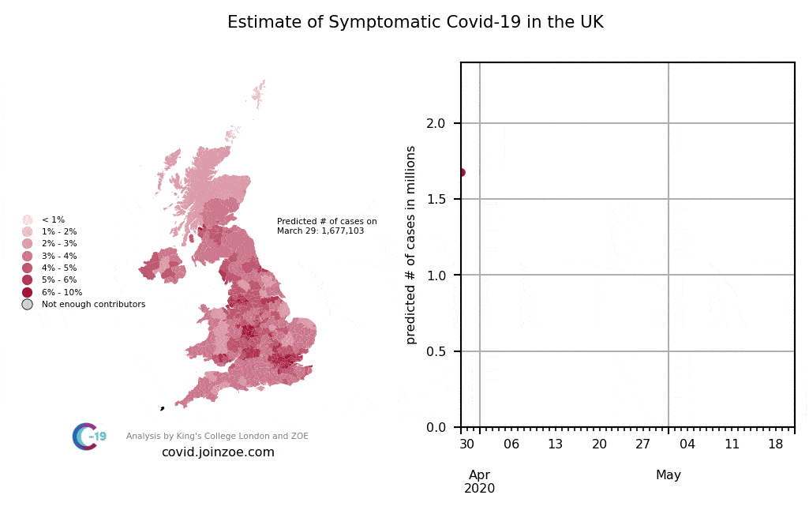
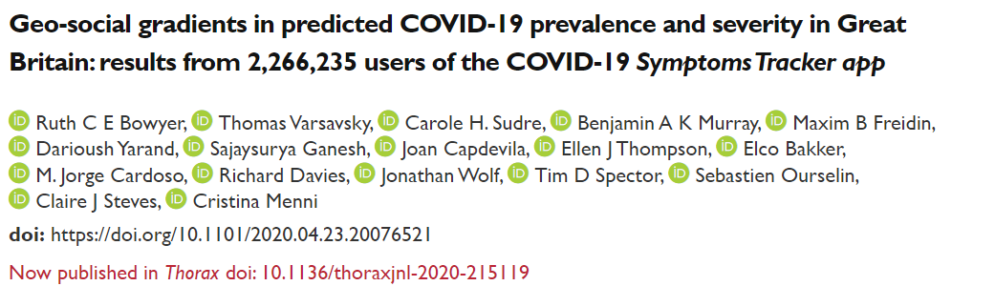
Data for public health - Dynamic evolution of symptoms over time and geography
First study to report that COVID was thriving in urban and more deprived areas
27th April 2020

Slide 9
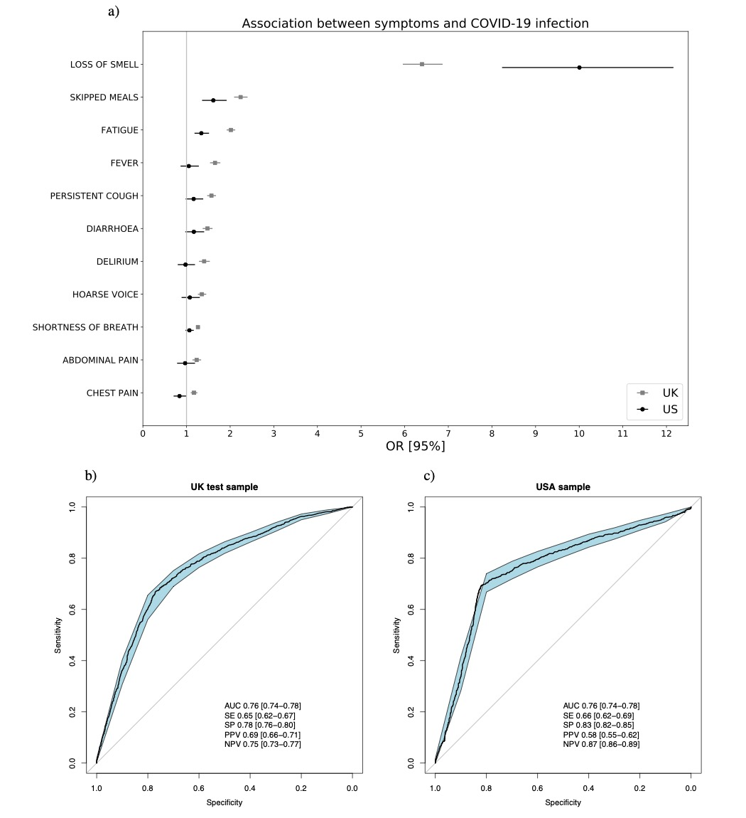
Logistic regression based Symptom score to predict positive cases
Model trained using symptoms at day of maximum aggregated symptom sum
Final score using:
Age
Gender
Loss of smell
Persistent cough
Skipped meals
Severe fatigue
Loss of smell strongest symptom predictor of Covid positivity
Real-time tracking of self-reported symptoms to predict potential COVID-19, Menni et al, Nature Medicine (2020)
Notes:
Loss of smell or taste as important predictor
Replication in both UK and US samples
Current work to analyse potential biases induced by testing policies

Slide 10
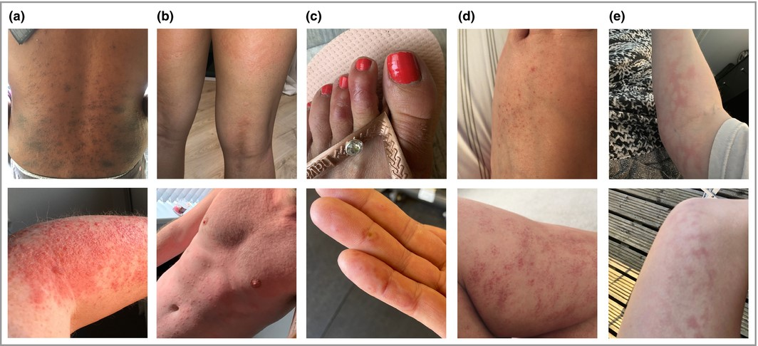

Community science: how the community drove insights
Our participants reported to us skin rashes and helped us develop new questions on the app
The also gave a catalogue of pictures of rashes associated

Slide 11
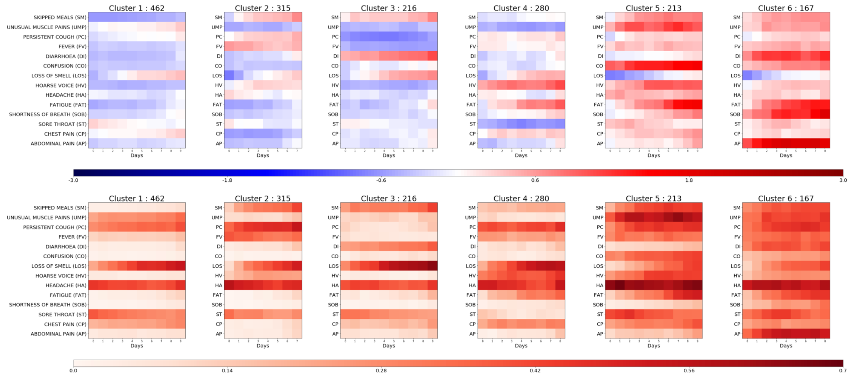
Leveraging longitudinal data - Symptom patterns for severity prediction
Random forest incorporating cluster identity, aggregated symptoms and personal characteristics (PC)
78% AUC when using cluster data vs 69% with only PC to predict need of respiratory support
Leveraging regular logging to investigate disease presentation over time
Identification of disease patterns
Used to predict need for respiratory support
Impact on patient monitoring
Sudre et al Science Advances
Notes:
Unsupervised time series clustering over the training set enabled us to distinguish six different clusters of symptom presentation.
To visualise how clusters differed we used the reported average occurrence of a symptom on each day for the median duration (Figure bottom) and the associated Z-Score for occurrence for each cluster with reference to the average presentation of one of the 14 reported symptoms (Figure top).
The clusters are ordered from left to right by rates of reported hospital visit with associated rates of respiratory support of 1.5%, 4.4%, 3.7%, 8.6%, 9.9% and 19.8% respectively.
Compared to Cluster 3 – 6, of which 8.6% - 19.8% required respiratory support, Cluster 1 and Cluster 2 represent milder forms of COVID-19 with 1.5% and 4.4%, respectively requiring respiratory support. These clusters showed predominantly upper respiratory tract symptoms and were distinguished from each other by the absence of muscle pain in Cluster 2 compared to Cluster 1, and slightly increased reports of skipped meals and fever in Cluster 2. Cluster 1 had notably lower mean age and BMI than the clusters containing patients with higher likelihood of requiring respiratory support
Using the first 5 days of symptom logging, the ROC-AUC of need for respiratory support was 78.8% , substantially outperforming personal characteristics alone (ROC-AUC 69.5%). Such an approach could be used to monitor at-risk patients and predict medical resource requirements days before they are required.

Slide 12
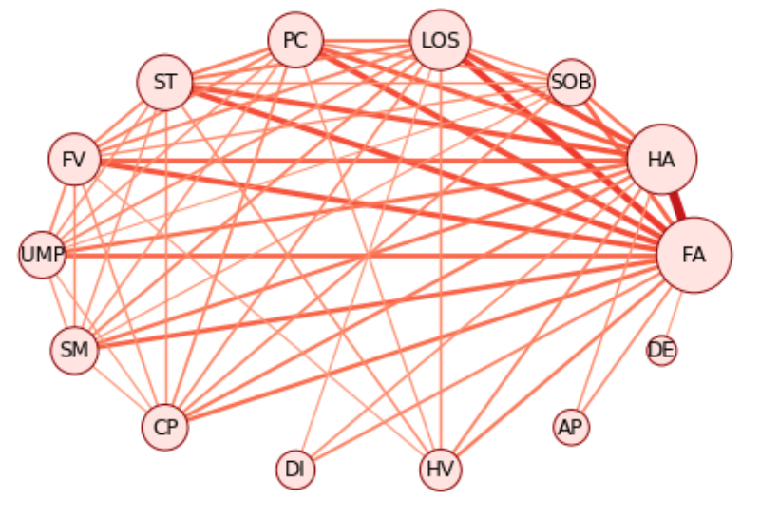
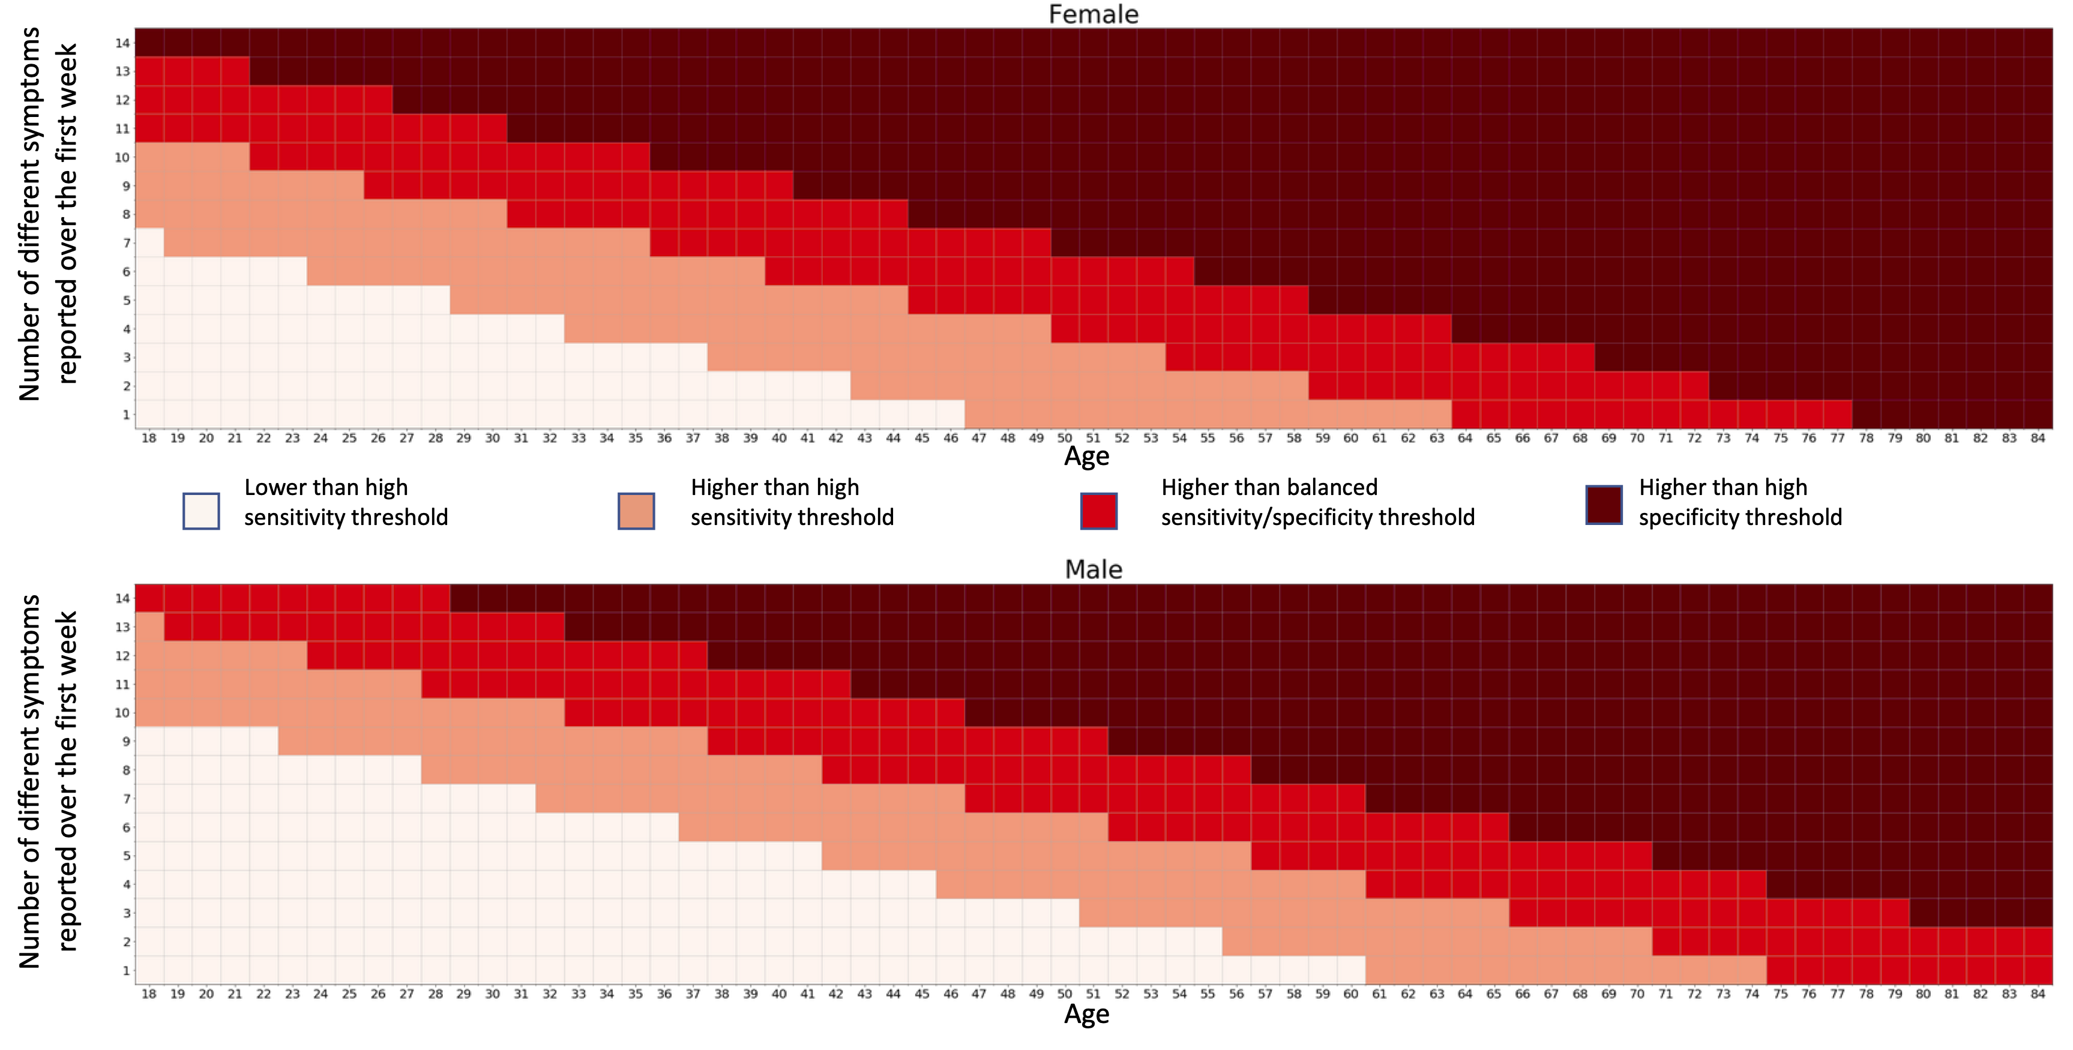
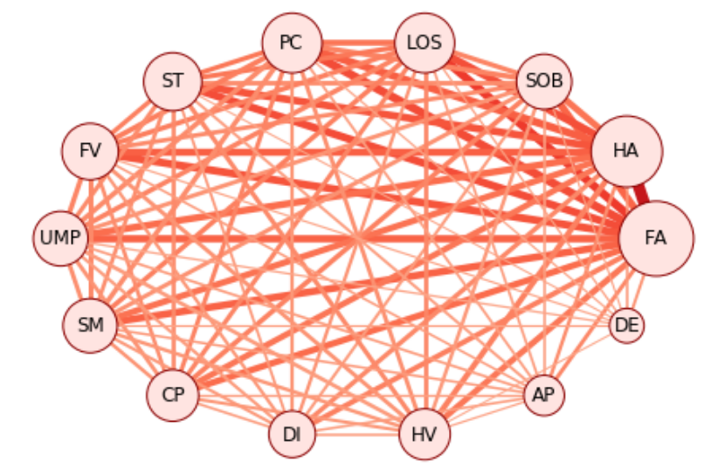
Leveraging longitudinal data – Early symptoms predictive of long duration
Prediction of risk of long covid (>=28 days) considering age, sex and number of symptoms experienced over first week
DE – delirium, AP – Abdominal Pain, HV – Hoarse Voice, DI – Diarrhoea, CP – Chest Pain, SM – skipped meals, UMP – Unusual Muscle pains, FV – Fever, ST – Sore Throat, PC – Persistent Cough, LOS – Loss of smell, SOB – Shortness of breath, HA – Headache, FA – Fatigue
Notes:
Matched 4182 COVID+ population-based cases:
Fatigue, Shortness of Breath and intermittent headache
Analysis of free text responses revealed neurological and cardiac symptoms were emerging 4-5 weeks into illness in some individuals

Slide 13
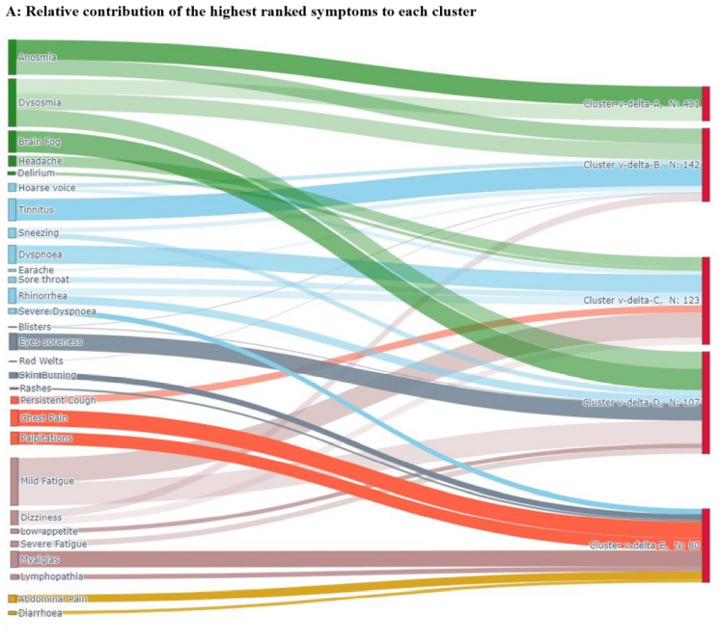
Long COVID - >84 days
Post COVID Syndrome can be subdivided by timeseries clustering
In all variants and vaccination types we saw:
a multisystem cluster
a respiratory cluster
and a neurological cluster.
.
Long Covid – Symptoms Clustering
liane.dos_santos_canas@kcl.ac.uk
Notes:
Using free text responses from people living with Long COVID, we added to the symptoms asked on the app. Unsupervised clustering of individuals by their symptoms reveals subtle differences between variants but the quality of the symptoms doesn’t change post vaccination in this community dwelling population. All variants studies had an anosmia cluster, a fatigue cluster, a respiratory and a multisystem cluster. This may be useful both in prognostication and in identifying mechanisms, and ultimately treatments.

Slide 14





How did we do it - A Team effort
Input on question design
Target for specific populations…
App development
Data extraction
Data cleaning
Data analysis
Modelling
Prediction
Disease understanding
Risk factors
Design of new research questions
Analysis of feedback from users
Public dissemination
Media
Governmental bodies
Website / App users
Academic dissemination

Slide 15
Data burden – Weight and complexity –ExeTera Platform
Data types
Patient (4.96M x 224 fields)
Assessments (266M x 66)
Tests (2.87M x 24)
Diet (1.58M x 97)
Vaccine doses: (179K x 15)
Vaccine symptoms: (348K x 28)
Vaccine hesitancy: (1.12M * 20)
Data weight
Daily snapshots ~ 62GB
Overall data ~ 20 TB
Too large and complex to load directly
Long interaction = less exploration
Lengthy processing
Error prone
Software available freely on HDR UK national platform

Slide 16
Continuous development
Launch in Sweden
Anosmia recognized as COVID-19 symptom by DHSC
Survey on type of test used
School campaign start
Launch in the US
Reporting by proxy
Postcode update
Survey on test criteria
Launch in the UK
Start wider testing
Recall for testing previously tested positive
Launch of diet study
Daily reminder
. . .
24/03
29/03
18/04
24/04
30/04
05/05
07/05
18/05
05/06
19/06
02/07
01/08
20/09
04/11
15/12
04/01
Ethnicity
Women health
Vitamin
Diabetes
Inclusion of loss of smell and taste
Test type updates
Refactorisation of symptom question – inclusion of new symptoms
Exposure – commute and masks
Isolation level
Reformulation
Clarification of previous conditions
Inclusion of muscle pains
Inclusion of dermatological and rarer symptoms
Mental health
Lifestyle
Vaccination question
+ Vaccination hesitancy
Mask usage
Notes:
Next time will need 2 pages…

Slide 17
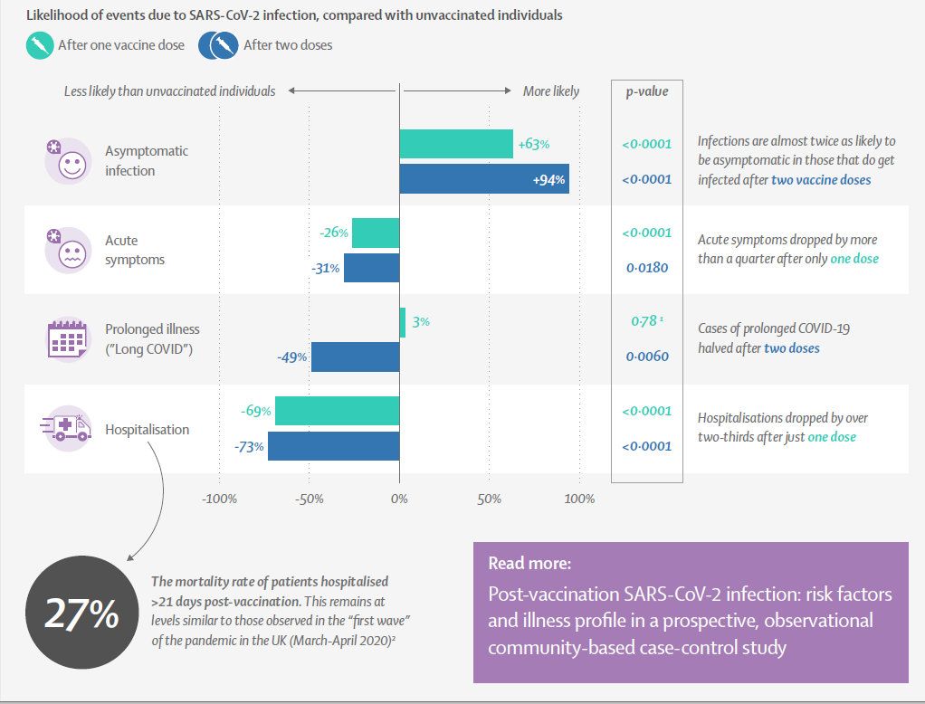
Post Vaccination Infection
Risk of Long-COVID reduced after vaccination
Compared symptom profiles in 6,030 single vaccinated and
2,370 double vaccinated individuals with unvaccinated individuals infected at the same time.
Antonelli et al, Lancet Infectious Diseases
https://doi.org/10.1016/S1473-3099(21)00460-6

Slide 18
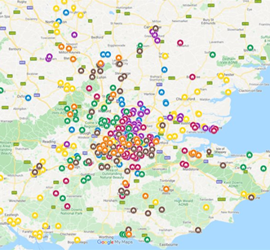
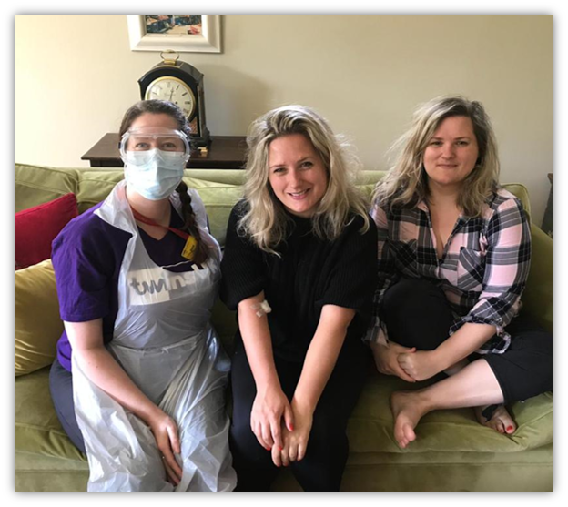
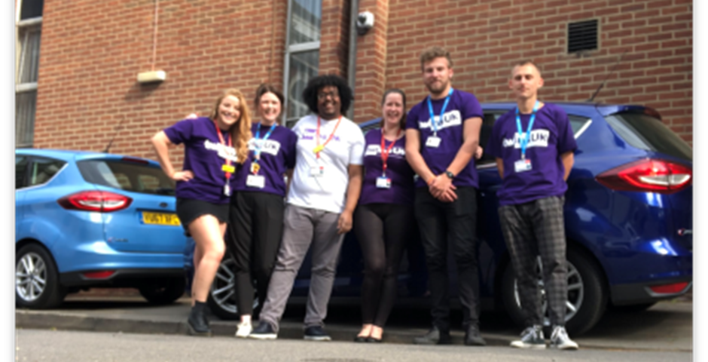
Meanwhile at Twins: Serology Home Visits
Home Visits
512 individual twins completed 1 visit (Apr-June)
Of those, 254 twins completed re-visited at 7-8 weeks (+ve Ab and co-twin)
Samples include: PCR swab, serum (ab Elisa), plasma, DNA bloods, saliva and stool + PBMCs
Additional home studies
Immune response
T-Cell
Longitudinal Ab on +ve twins and co-twins
Notes:
A number of immune trials based at twins homes
Peak of pandemic
Genetics based study with twin pairs
In collaboration with Mike Malim’s Lab and Katie Doores
Immune response – Adrian Hayday
T cells – Tim Tree - 4 gps predicitive covid +ve –ve, Ab +ve –ve
Longitudinal – ongoing f/up of the Ab =ve twins and their co=twin every 3 mths with postal blood for Ab response

Slide 19
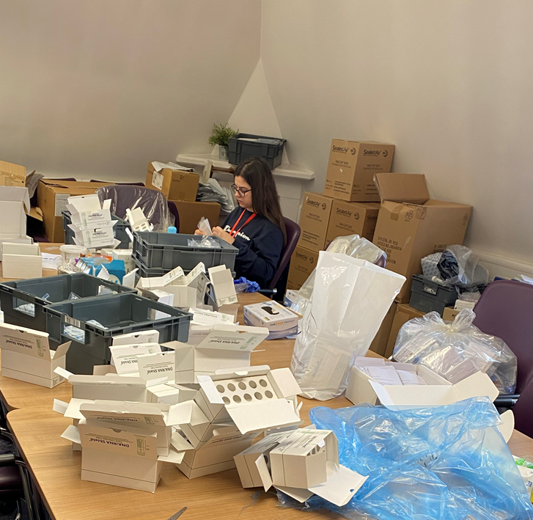
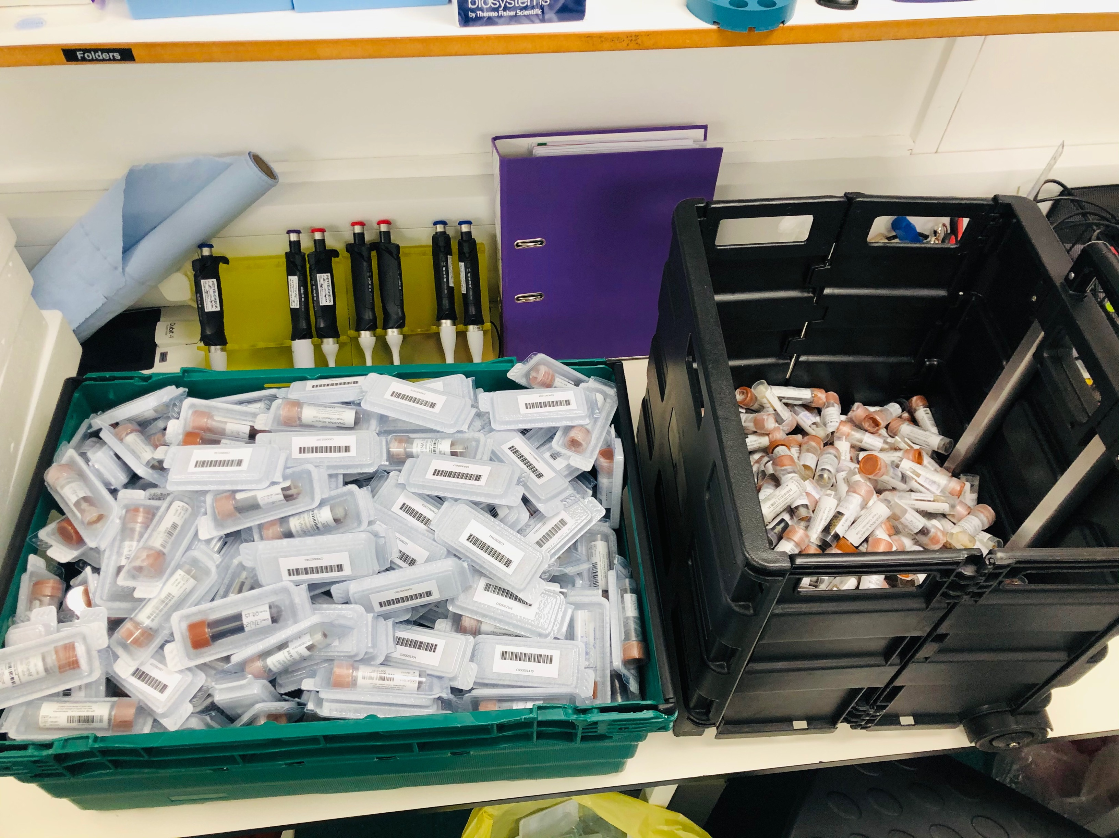
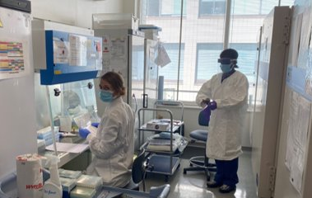
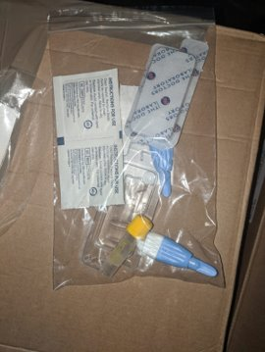
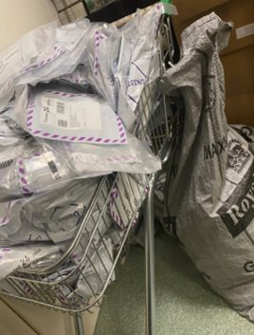
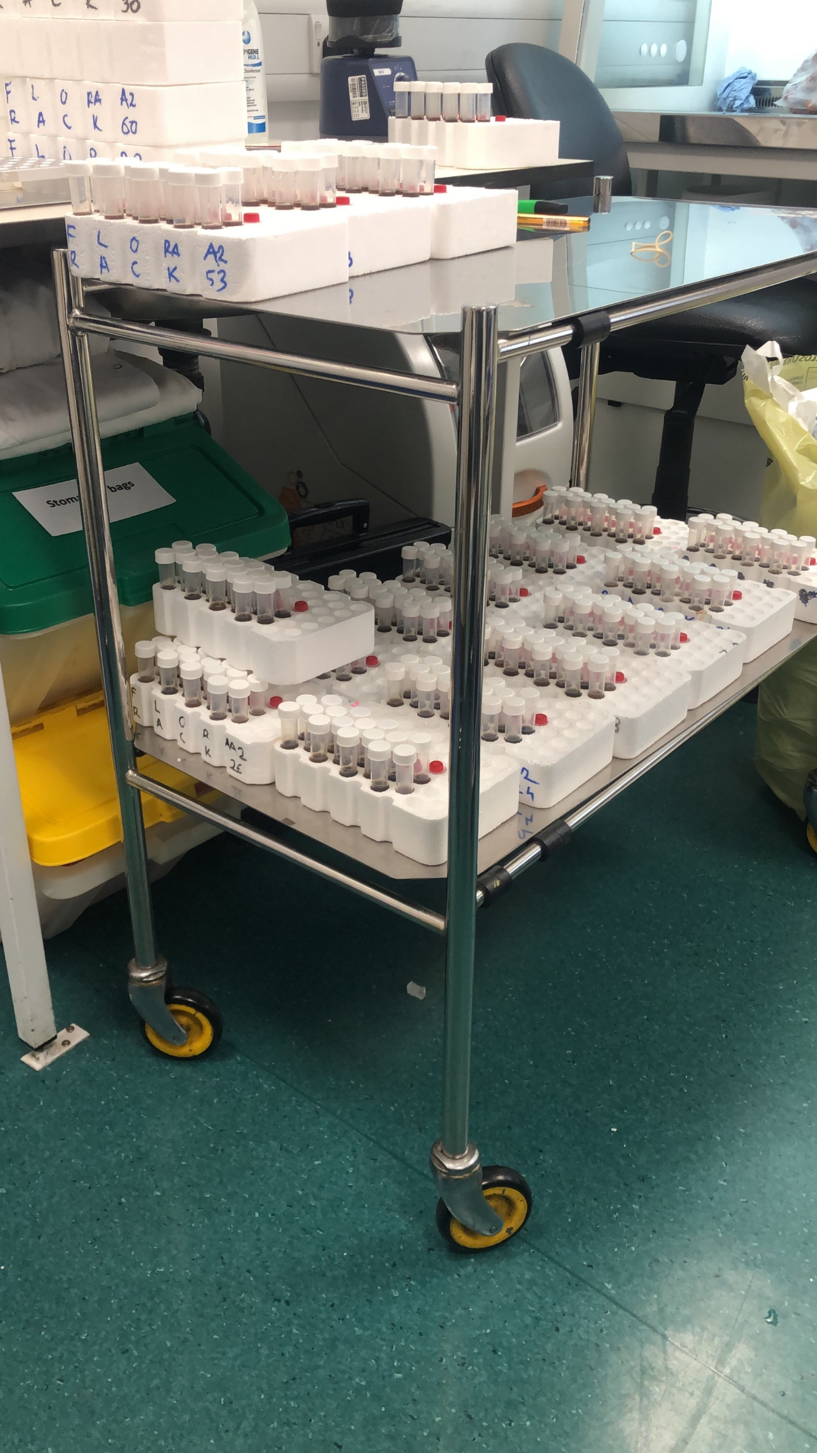
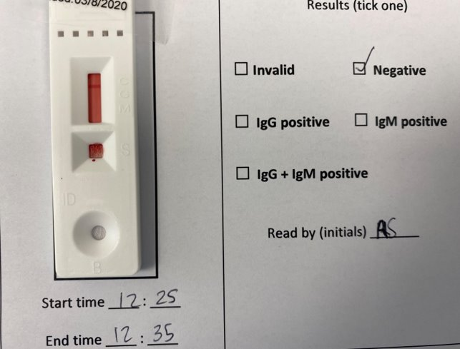
Step 1:
Invite
&
Send Packs
Step 2:
Reciept & Process Samples
Step 3:
Antibody Testing
&
Storage
Step 4:
Results Reporting
Notes:
Kit with 600ml blood, clamshell return, 24 hr PO deliveries
Social distanced job for packing 7000 kits in short time frame
600 samples processed a day in 3 labs to accommodate distancing
Lab tech spin, nurse performed lat flow
Plated all samples for Elisa in MM lab
Ab results fed back to twins

Slide 20


COVID-19 Longitudinal Health and Wellbeing
National Core Study
Longitudinal Linkage Collaboration
Society
and Health
Serology
Mental Health
Vaccination
Healthcare Disruption
Long-COVID
Research Themes

Slide 21

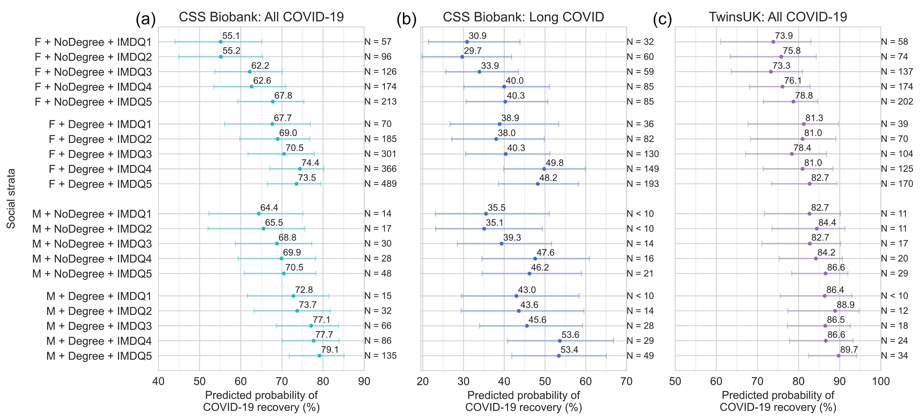

Inequalities in Long-COVID-19 recovery
Method: MAIHDA mixed-effects model. Strata comprise Sex + Education + Deprivation.
MAIHDA tutorial: Evans 2024, https://doi.org/10.1016/j.ssmph.2024.101664
Cheetham, submitted

Slide 22

Quantitative analysis of qualitative coded free text
Q. “Please use the space below to tell us a bit more about any care you received for COVID-19?
For example, was it easy to see your GP?
Were there any parts of your treatment that were particularly helpful or that you think could be improved?
Please write as much or as little as you like about any aspects of your healthcare experience.”
Disadvantaged
Intermediate
Advantaged
Grouping based on: Ethnic group, Education, Employment status, Deprivation & Income

Slide 23
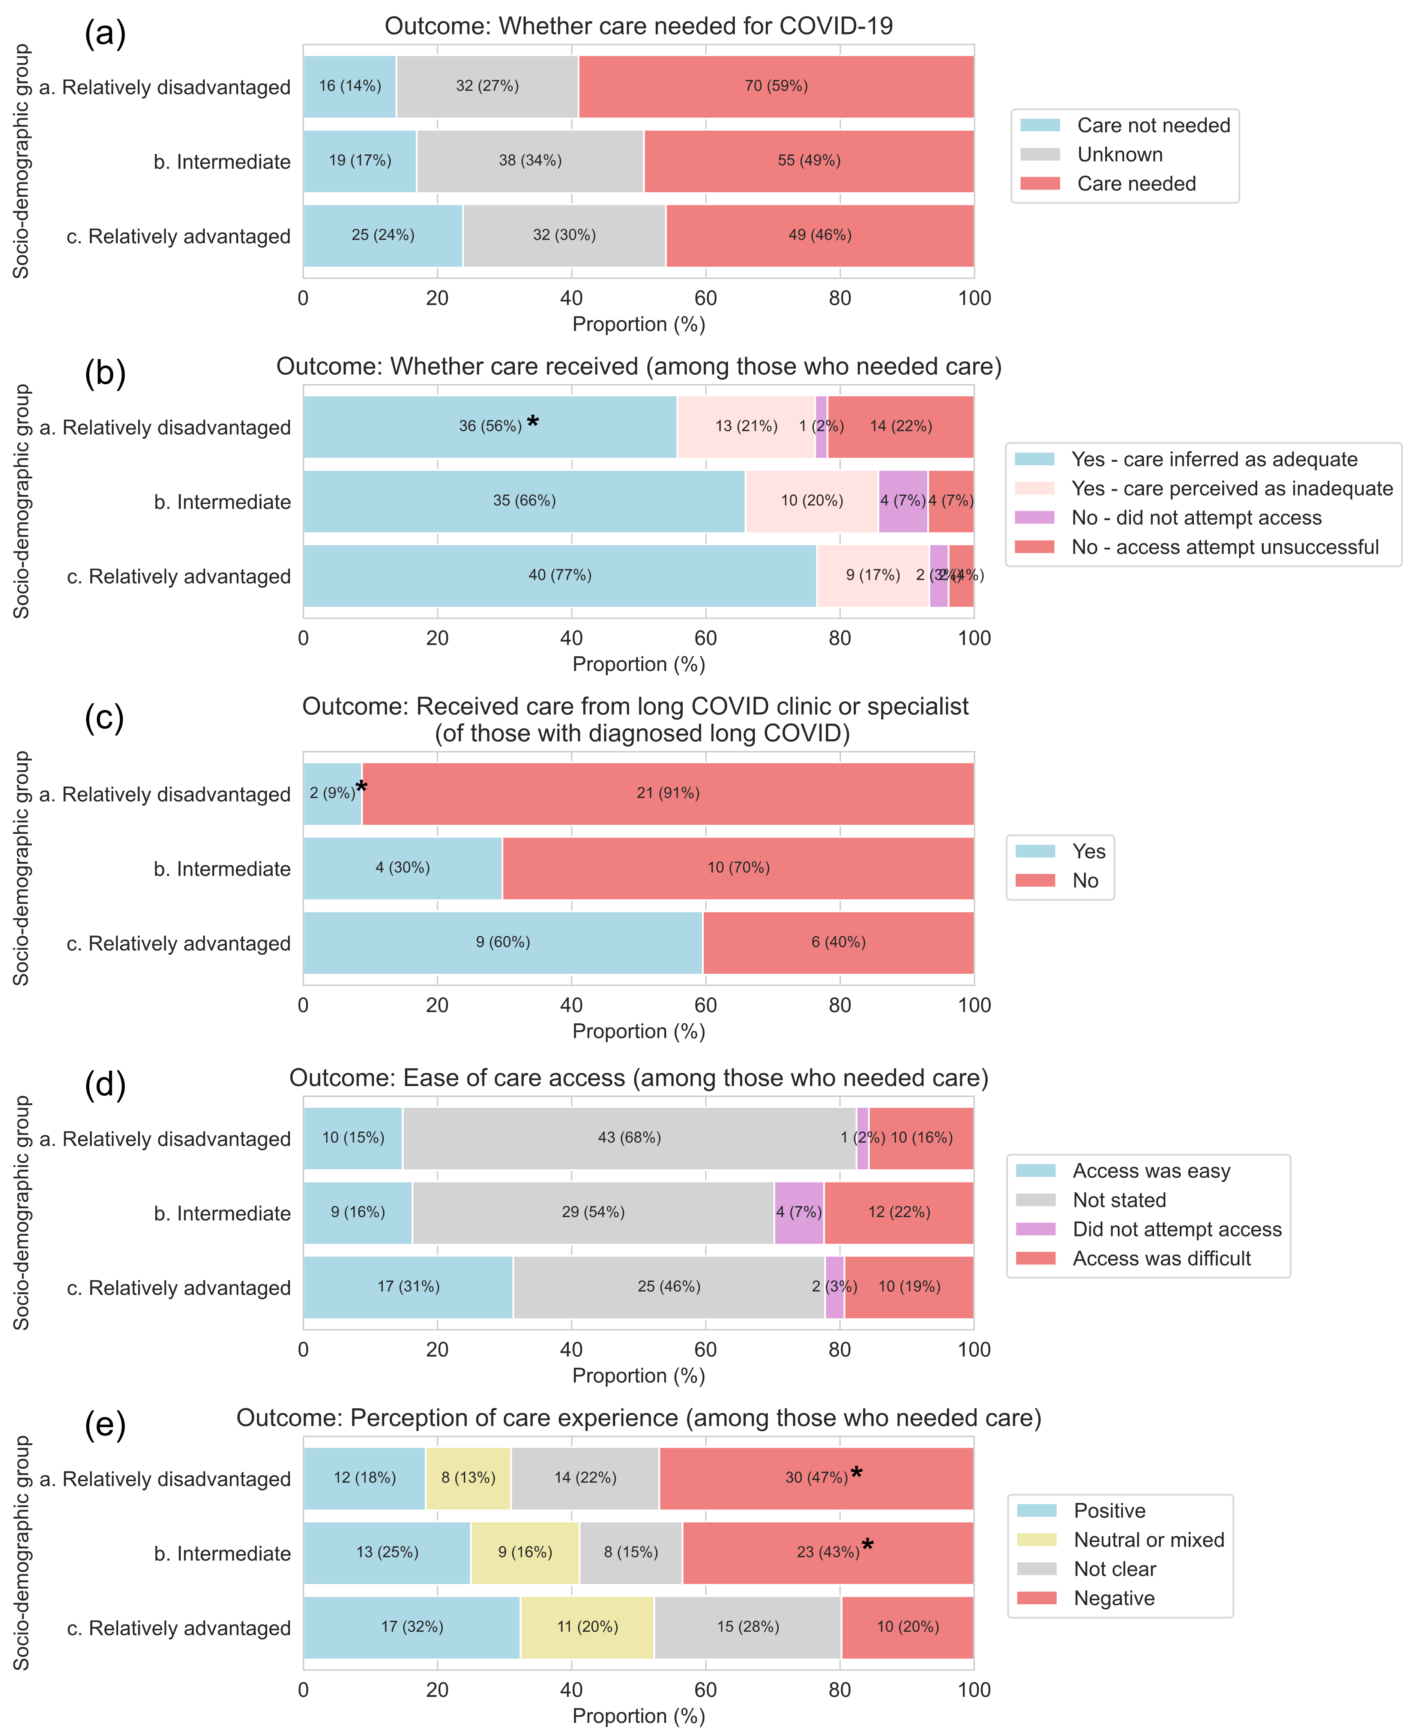
Quantitative analysis of qualitative coded free text
Care need:
Care receipt:
Method: Quantitative analysis of subset of 335 qualitatively coded free-text responses (Coding by: JD Carpientieri, Anoushka Beattie, Alastair Comery)
Subsets based on: Ethnic group, Education, Employment status, Deprivation, & Income

Slide 24
Large language model thematic analysis
Advantaged
N = 109
Positive experiences with healthcare access
Post-COVID-19 follow-up (positive)
Difficulty Accessing Care
Misdiagnosis or inadequate diagnosis
Method: Llama 3.2 Large-language model analysis of 335 free-text responses
LLM Prompt: “Please summarise the key themes across the responses.”
Subsets based on: Ethnic group, Education, Employment status, Deprivation, & Income

Slide 25
Large language model thematic analysis
Advantaged
N = 109
Positive experiences with healthcare access
Post-COVID-19 follow-up (positive)
Difficulty Accessing Care
Inadequate Support for Symptoms
Misdiagnosis or inadequate diagnosis
Poor Communication and Follow-Up
Good response after hospitalization
Intermediate
N = 117
Method: Llama 3.2 Large-language model analysis of 335 free-text responses
LLM Prompt: “Please summarise the key themes across the responses.”
Subsets based on: Ethnic group, Education, Employment status, Deprivation, & Income
Use of digital channels

Slide 26
Large language model thematic analysis
Disadvantaged
N = 109
Advantaged
N = 109
Bureaucratic Barriers
Positive experiences with healthcare access
Inadequate Referrals
Emotional Toll
Lack of Awareness and Training (long COVID)
Post-COVID-19 follow-up (positive)
Difficulty Accessing Care
Inadequate Support for Symptoms
Misdiagnosis or inadequate diagnosis
Poor Communication and Follow-Up
Good response after hospitalization
Intermediate
N = 117
Method: Llama 3.2 Large-language model analysis of 335 free-text responses
LLM Prompt: “Please summarise the key themes across the responses.”
Subsets based on: Ethnic group, Education, Employment status, Deprivation, & Income
Use of digital channels

Slide 27
Future impact?
Preparing for a future pandemic
Currently preparing a report for the COVID enquiry
Understanding inequalities
In onset, recovery and access to care
Understanding geography and health – climate change
Helping you plan and carry out your research ….

Slide 28
Multiple intersecting skillsets
User interface
Claire Steves
Elana Jeeaooo
Abu Buwe
Christina Hu
Data Analytics
Joan Capdevila
Carole Sudre
Mark Graham
Thomas Varsavsky
Michela Antonelli
Kerstin Klaser
Marc Modat
Liane Dos Santos
Lorenzo Polidori
Ana May
Ethics and Data Governance
Richard Davies
Paz Garcia
Darioush Yarand
Sarah Berry
Valentina Vitiello
Vicky Bowyer
Public Relations
Sara Gordon
Ellie Griffiths
Kat Arney
Rebecca Lewis
Tanya Wood
Clinical questions and interpretation
Claire Steves
Mary Ni Lochlainn
Bea Zazzara
Rose Penfold
Karla Lee
Emma Duncan
Alexander Hammers
Marc Osterdahl
Engineering
Julien Lavigne du Cadet
Sajaysurya Ganesh
Ben Murray
Eric Kerfoot
Jie Deng
Liyuan Chen
Political leadership
Tim Spector
Jonathan Wolf
Seb Ourselin
Writing
Christina Menni
Geo-spatial analysis
Ruth Bowyer

Slide 29
Thanks to all our participants
Claire.j.steves@kcl.ac.uk
Professor of Ageing and Health

Slide 30
With thanks to all our contributors! DHSC, CDRF and our other funders
Email me on claire.j.steves@kcl.ac.uk

